Slide 1
CSC 362: System Programming
Git Setup
Original slides by: Amitabha Dey
Adapted by: Dr. Richard Johnson
Department of Computer Science University of North Carolina at Greensboro

Slide 2

Status Check
Understanding Shells (CLI)
Terminal Commands
  Navigation Commands
  File Manipulation Commands
  Environment Variables
What we will cover today
GitHub Commands
  Configuring Git
  Authentication using SSH
  Basic Git Workflow

Slide 3



Install Git
Verify Git installation:
git --version
If not installed, download and install Git from git-scm.com.
Configure your git username and email:
git config --global user.name "Your Name"
git config --global user.email "your.email@example.com"

Slide 4
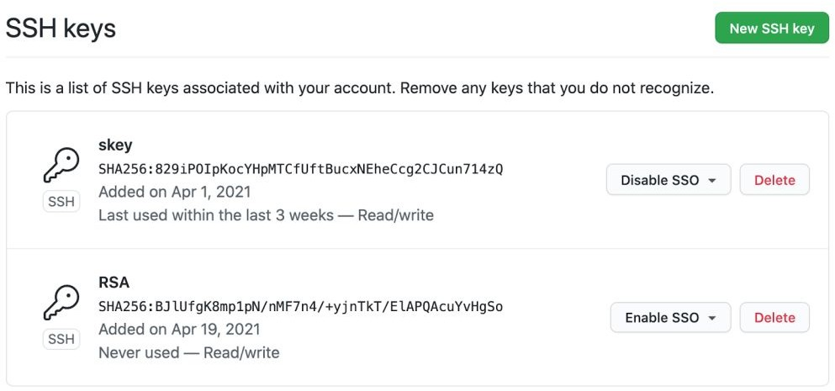
Authentication Using SSH
Generate an SSH key to authenticate with GitHub without entering a password every time:
ssh-keygen -t ed25519 -C "your.email@example.com"
Press Enter to accept the default save location and optionally set a passphrase.
Copy the SSH Key to Your Clipboard:
macOS: cat ~/.ssh/id_ed25519.pub
Image credit - https://github.blog/
Linux: cat ~/.ssh/id_ed25519.pub

Slide 5
Authentication Using SSH (cont.)
Add the SSH key to your GitHub account:
Go to GitHub → Settings → SSH and GPG Keys
→ New SSH Key.
Paste the key and save.
  Test the SSH Connection:
ssh -T git@github.com
Image credit - https://github.blog/

Slide 6
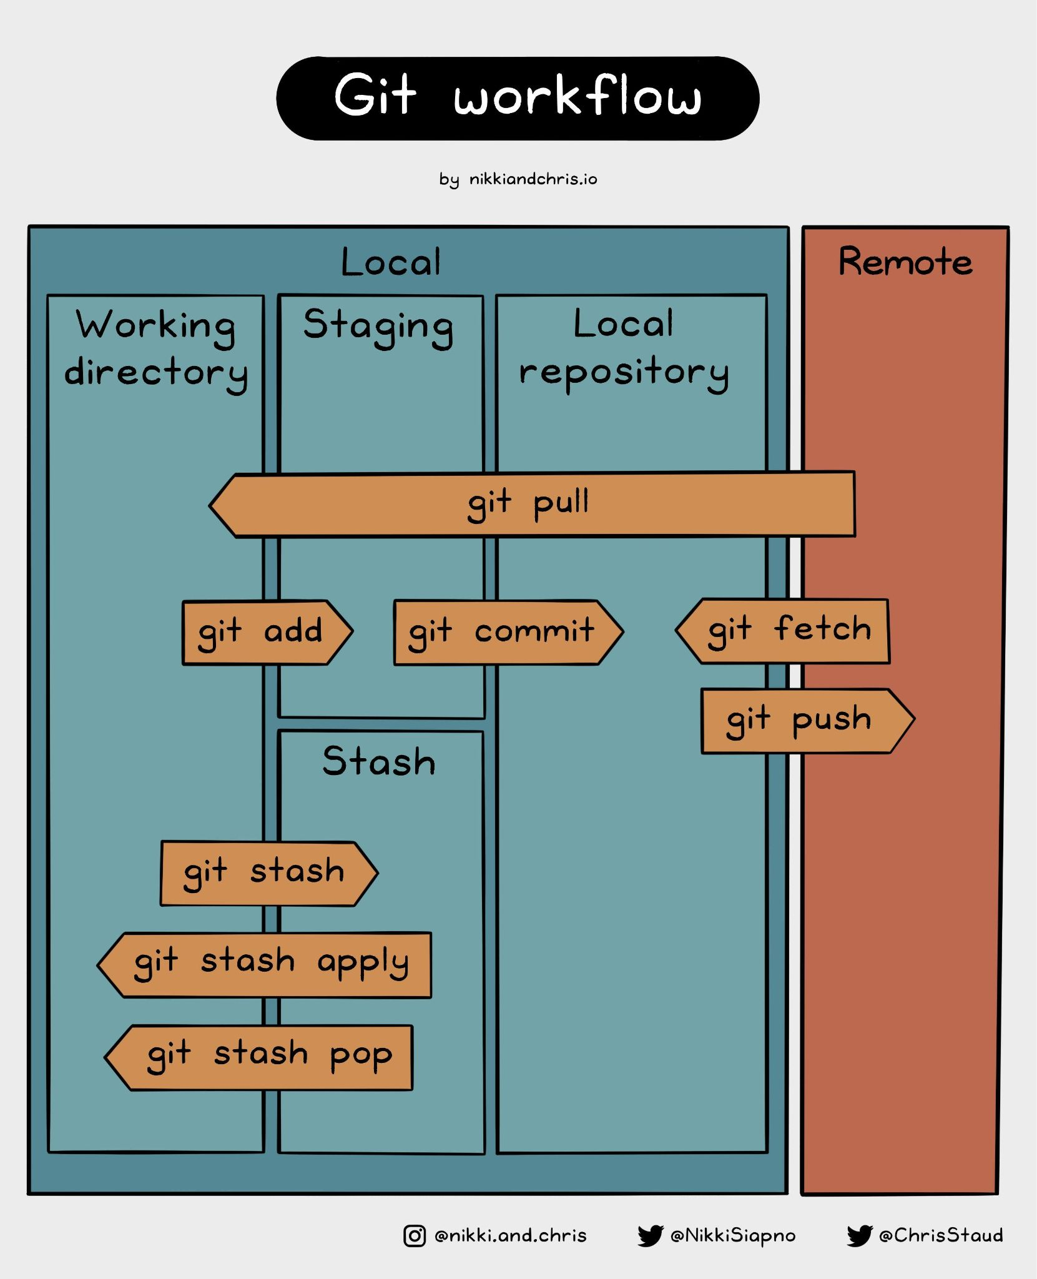
Basic Git Workflow
Initialize a repository:
git init
Add all changes:
git add .
Commit changes:
git commit -m <message>
Push the Changes to the Remote Repository
git push -u origin master

Slide 7
Add Files to It and Push It to the Repository
git push
  This command is used to upload local repository changes to a remote repository.
  It sends commits from your local branch to a corresponding branch in the remote repository.
-u (or --set-upstream)
  This flag sets the upstream branch for the local branch.
  It links your local branch (in this case, master) to the remote branch (on origin).
  After running this command once, future git push and git pull commands can be executed without specifying the remote and branch name.
origin
  This refers to the default remote repository where your code is stored.
  When you clone a repository, Git automatically names the original repository as origin.
master
  This is the branch name you are pushing to the remote repository.
  By default, Git creates a branch called master in older repositories, but newer versions use main as the default.
Initialize a repository:
git init
Add all changes:
git add .
Commit changes:
git commit -m <message>
Push the Changes to the Remote Repository
git push -u origin master

Slide 8
Add Files to It and Push It to the Repository (2)
git remote
Manages remote repository connections.
Allows you to add, remove, or list remote repositories.
add
Adds a new remote repository to your local Git project.
origin
This is the default name given to the remote repository.
You can name it something else, but origin is the convention.
<repository_url>
The URL of the remote repository (on GitHub, GitLab, Bitbucket, etc.).
Create a New Repository on GitHub
  Go to GitHub and log in to your account.
  Click the "+" icon in the upper-right corner and select "New repository."
  Name your repository (e.g., my-new-repo) and click "Create repository."
Link Your Local Repository to a Remote Repository:
git remote add origin <repository_url>

Slide 9
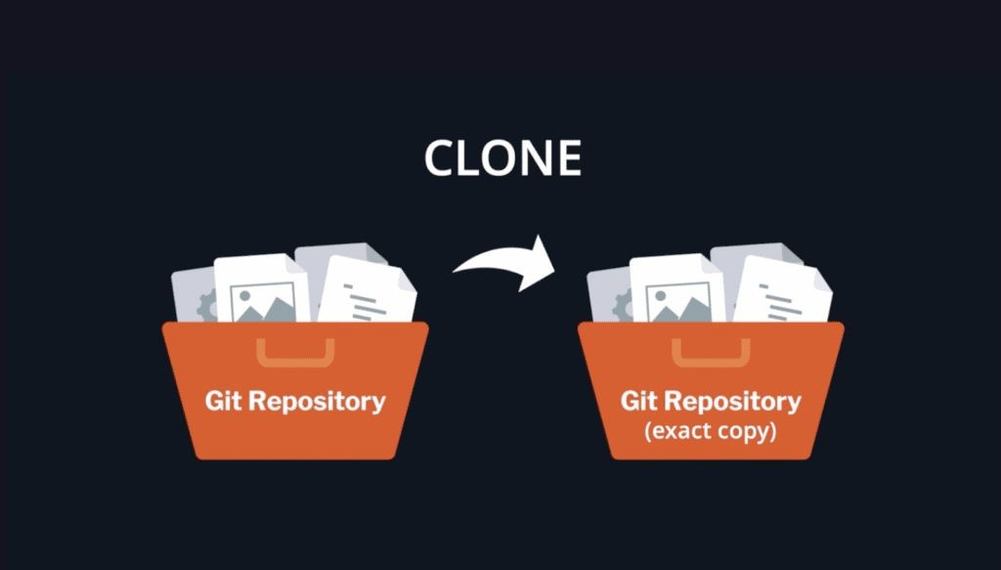
Clone an Existing GitHub Repository
Clone a Repository:
git clone <repository_url>
Clone a Specific Branch:
git clone --branch <branch_name> <repository_url>
Image credit - https://www.gitkraken.com/

Slide 10
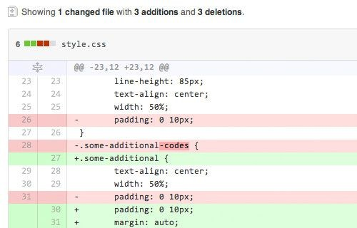
Track Differences
Check the Status of the Repository:
git status
See the Differences in Your Changes:
git diff
Compare Local Branch with Remote Branch:
git log HEAD..origin/master
git diff HEAD origin/master
Image credit - https://www.hongkiat.com/

Slide 11
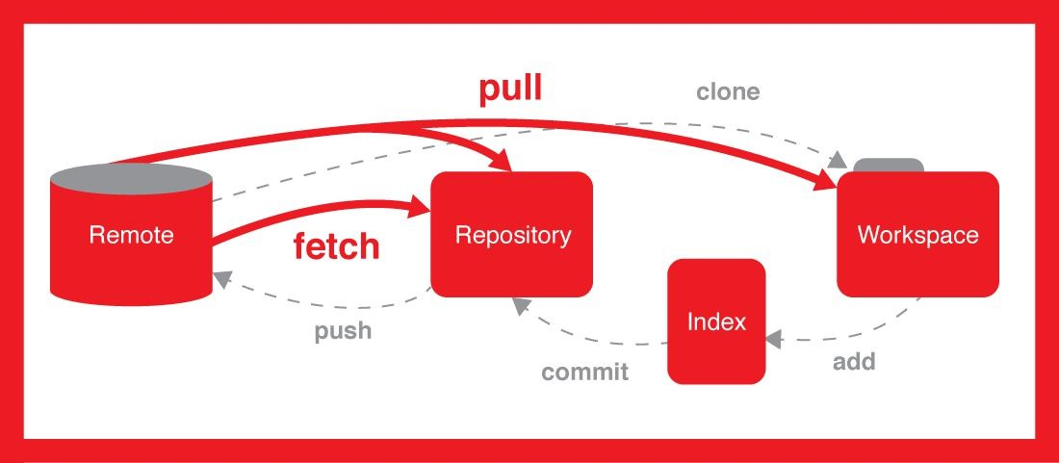
Pulling Changes from the Cloud
Fetch The Latest Changes:
git fetch origin
Decide Whether to Pull:
git pull origin master
Image credit - Alireza @ Stack Overflow

Slide 12
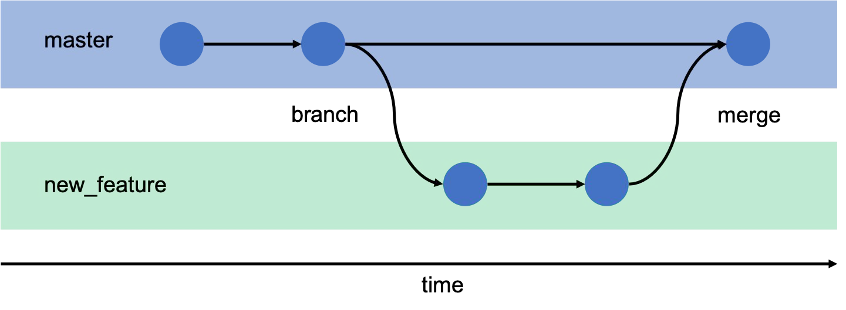
Git Branching and Merging
View the current status
git status
Create a new branch
git branch feature-xyz
Switch to a new branch
Image credit - https://gitbookdown.dallasdatascience.com/
git checkout feature-xyz

Slide 13

The Repository and GitHub User
View the Commit History:
git log
View Remote Repository Info:
git remote -v
List All Branches:
git branch -a
List All Tags:
git tag
View a Specific Commit:
git show <commit-hash>

